Slide 1
地震工程期末報告
Earthquake Engineering Final Report
Crew member:
涂子彧11372011
邱昱倫11372009
周芷琦11372004
Presentation Date : Jun. 5th , 2025

Slide 2
Before we start…
三層樓剪力屋架運動方程式
多自由度系統求解過程
應用python編寫程式碼
Newmark-beta的線性加速度法(α=1/2,β=1/6)
三種質量協調阻尼器Tuned Mass Damper在減震的功效探討
集集地震、阪神大地震的結果比較

Slide 3
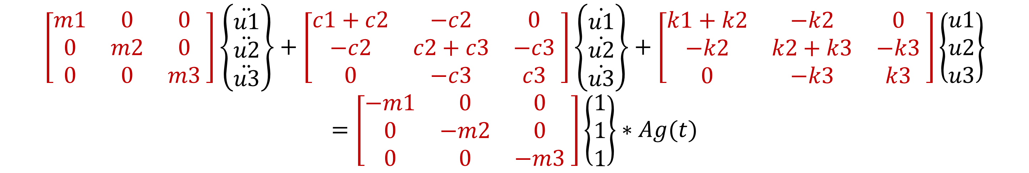
Analytical dynamic equation
SDOF system equation
$$m\ddot{u}+c\dot{u}+ku=−m∗Ag(t)$$
MDOF system equation
$$\left[\begin{matrix}m1 & 0 & 0 \\ 0 & m2 & 0 \\ 0 & 0 & m3\end{matrix}\begin{matrix} \\ \end{matrix}\right]\left\{\begin{matrix}\ddot{u1} \\ \ddot{u2} \\ \ddot{u3}\end{matrix}\right\}+\left[\begin{matrix}c1+c2 & −c2 & 0 \\ −c2 & c2+c3 & −c3 \\ 0 & −c3 & c3\end{matrix}\begin{matrix} \\ \end{matrix}\right]\left\{\begin{matrix}\dot{u1} \\ \dot{u2} \\ \dot{u3}\end{matrix}\right\}+\left[\begin{matrix}k1+k2 & −k2 & 0 \\ −k2 & k2+k3 & −k3 \\ 0 & −k3 & k3\end{matrix}\begin{matrix} \\ \end{matrix}\right]\left\{\begin{matrix}u1 \\ u2 \\ u3\end{matrix}\right\}=\left[\begin{matrix}−m1 & 0 & 0 \\ 0 & −m2 & 0 \\ 0 & 0 & −m3\end{matrix}\begin{matrix} \\ \end{matrix}\right]\left\{\begin{matrix}1 \\ 1 \\ 1\end{matrix}\right\}∗Ag(t)$$

Slide 4
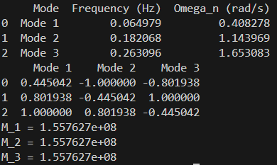
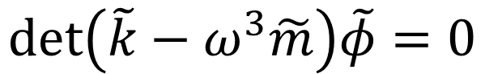
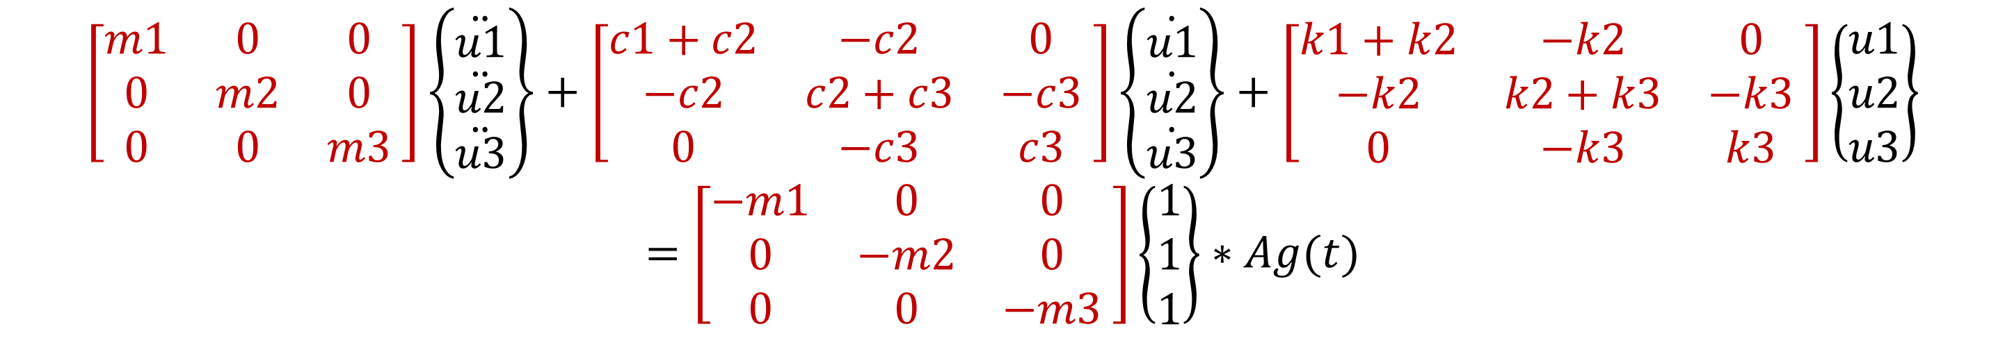
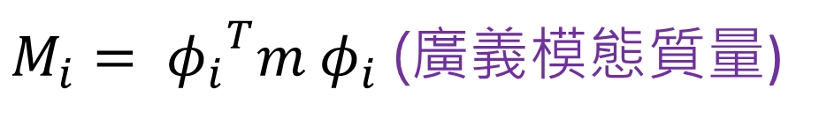
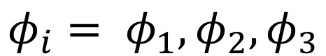
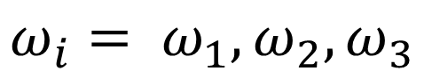
Analytical dynamic equation
MDOF system equation
$$\left[\begin{matrix}m1 & 0 & 0 \\ 0 & m2 & 0 \\ 0 & 0 & m3\end{matrix}\begin{matrix} \\ \end{matrix}\right]\left\{\begin{matrix}\ddot{u1} \\ \ddot{u2} \\ \ddot{u3}\end{matrix}\right\}+\left[\begin{matrix}c1+c2 & −c2 & 0 \\ −c2 & c2+c3 & −c3 \\ 0 & −c3 & c3\end{matrix}\begin{matrix} \\ \end{matrix}\right]\left\{\begin{matrix}\dot{u1} \\ \dot{u2} \\ \dot{u3}\end{matrix}\right\}+\left[\begin{matrix}k1+k2 & −k2 & 0 \\ −k2 & k2+k3 & −k3 \\ 0 & −k3 & k3\end{matrix}\begin{matrix} \\ \end{matrix}\right]\left\{\begin{matrix}u1 \\ u2 \\ u3\end{matrix}\right\}=\left[\begin{matrix}−m1 & 0 & 0 \\ 0 & −m2 & 0 \\ 0 & 0 & −m3\end{matrix}\begin{matrix} \\ \end{matrix}\right]\left\{\begin{matrix}1 \\ 1 \\ 1\end{matrix}\right\}∗Ag(t)$$
Find Eigenvector ϕ
$$\det\left(\tilde{k}−ω^{3}\tilde{m}\right)\tilde{φ}=0$$
$$ω_{i}= ω_{1},ω_{2},ω_{3}$$
$$φ_{i}= φ_{1},φ_{2},φ_{3}$$
$M_{i}= {φ_{i}}^{T}m φ_{i}$ (廣義模態質量)

Slide 5
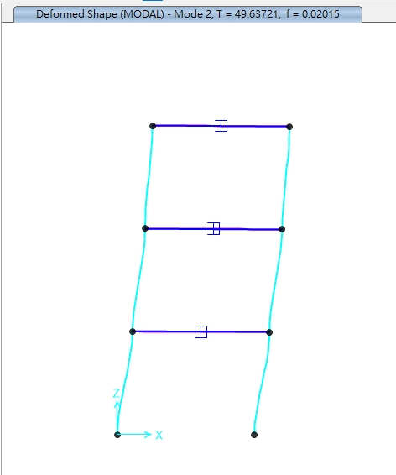
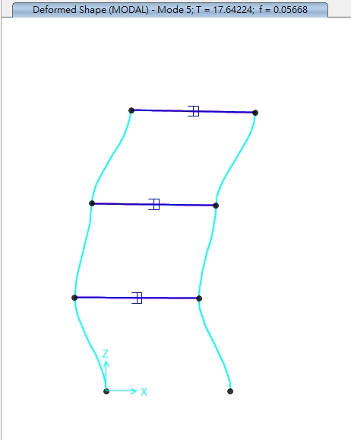
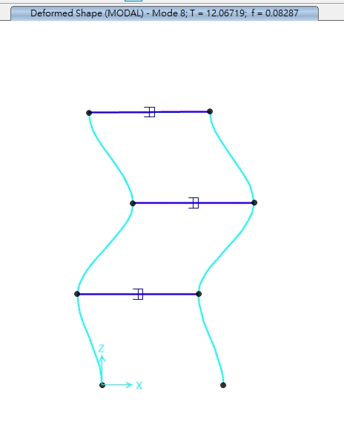
Analytical dynamic equation
Case | Frequency (Hz) | Period (s) | Omega_n (rad/s)
Original | 0.064979 | 15.38949 | 0.408278
TMD_7 | 0.064846 | 15.42119 | 0.407438
TMD_8 | 0.063517 | 15.74370 | 0.399092
TMD_9 | 0.060509 | 16.52654 | 0.380188

Slide 6

Newmark beta
Linear acceleration method
α = 1/2
β = 1/6
.

Slide 7
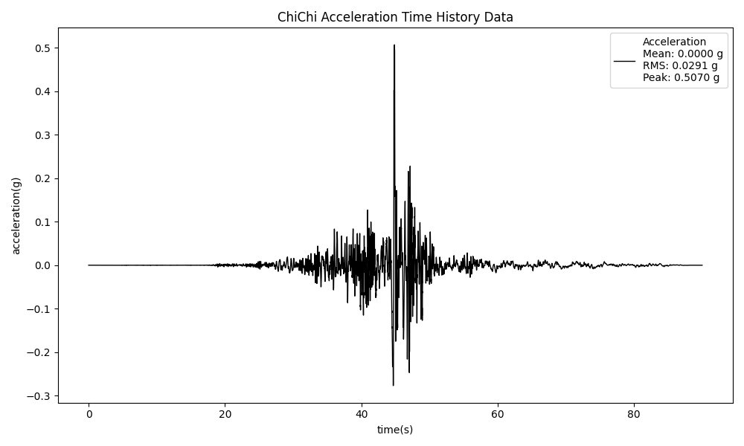
集集地震的平均值、尖峰值、均方根值
平均值 Mean | 2.26e-7 g
均方根值 RMS | 0.0291 g
尖峰值 Peak | 0.507 g

Slide 8
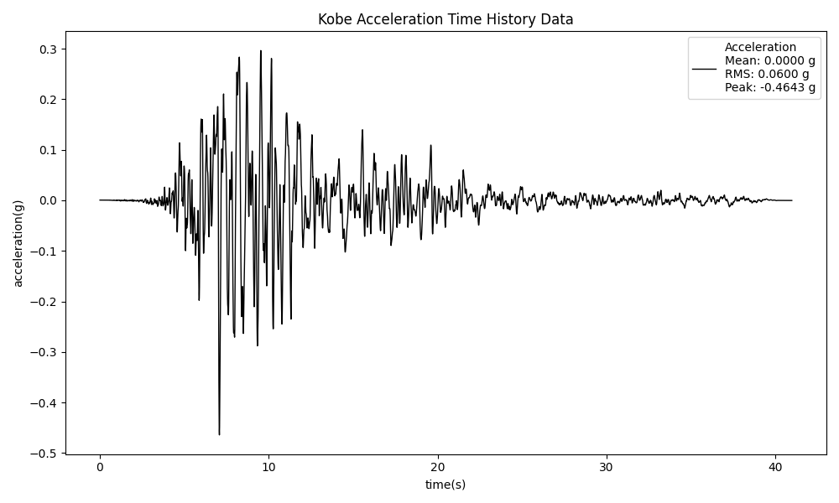
阪神地震的平均值、尖峰值、均方根值
平均值 Mean | 2.26e-7 g
均方根值 RMS | 0.06 g
尖峰值 Peak | -0.4643 g

Slide 9
Parameters of three Tuned Mass Dampers
質量協調阻尼器的參數
Damper No. 7 | 質量比 | 0.03
 | 調協頻率比 | 0.9592
 | 阻尼比 | 0.0857
Damper No. 8 | 質量比 | 0.1
 | 調協頻率比 | 0.8789
 | 阻尼比 | 0.1527
Damper No. 9 | 質量比 | 0.2
 | 調協頻率比 | 0.7815
 | 阻尼比 | 0.2098

Slide 10

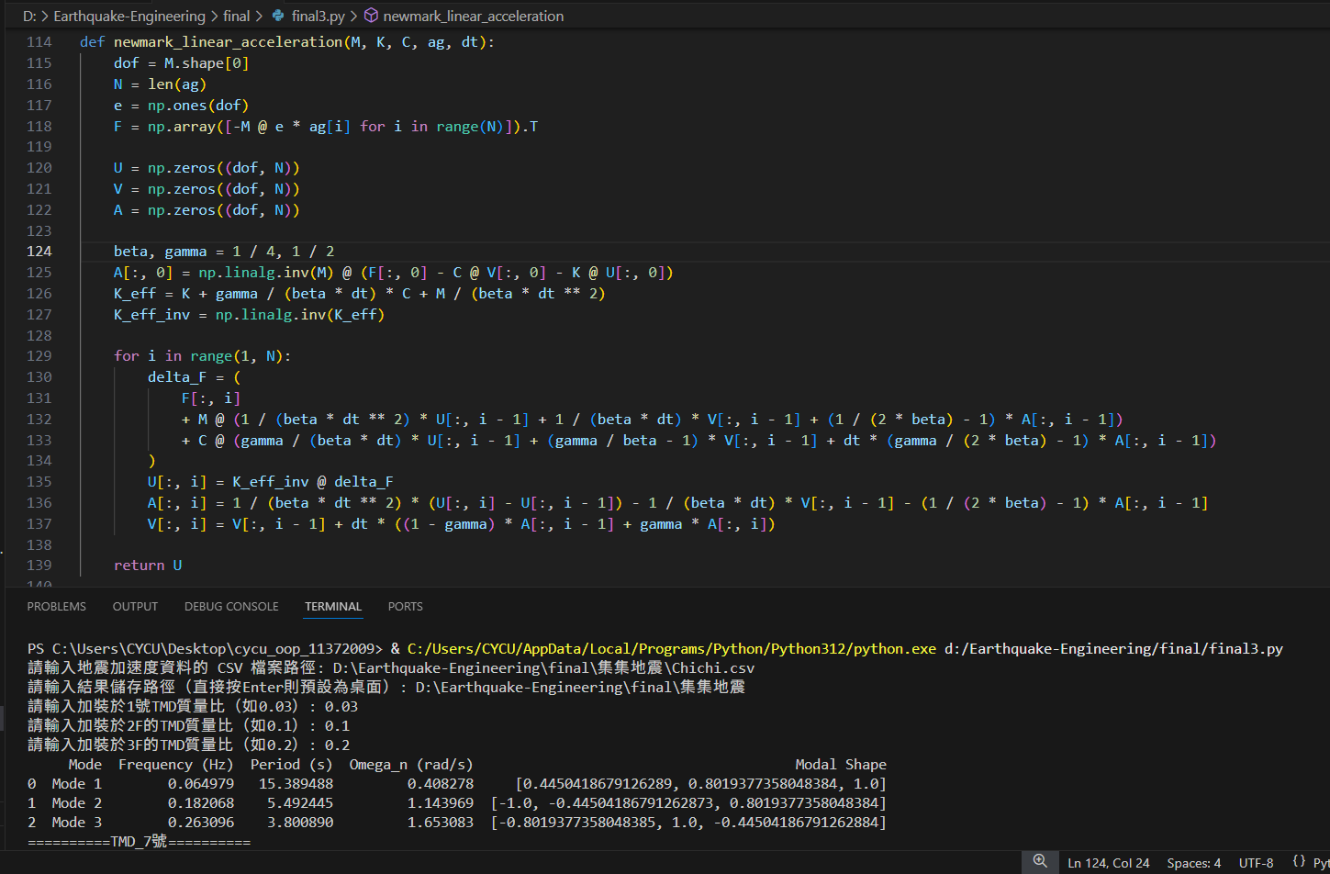
Use Python to find calculate solutions.

Slide 11
ChiChi Results from Python code
with illustration and comparison

Slide 12
Linear Acceleration-displacement outcome
No.7 Damper
*PEAK | R.E. | 1.87 | %
*MEAN | R.E. | 1.87 | %
*RMS | R.E. | 11.97 | %
No.8 Damper
*PEAK | R.E. | 2.65 | %
*MEAN | R.E. | 15.57 | %
*RMS | R.E. | 8.72 | %
No.9 Damper
*PEAK | R.E. | 8.93 | %
*MEAN | R.E. | 50.74 | %
*RMS | R.E. | 32.07 | %
1F | PEAK (m) | MEAN (m) | RMS (m)
原結構 | 1.692983e-02 | -1.200073e-04 | 5.766438e-03
No.7 Damper | 1.661348e-02 | -1.195013e-04 | 5.076288e-03
No.8 Damper | 1.648044e-02 | -1.386916e-04 | 5.263631e-03
No.9 Damper | 1.541835e-02 | -5.911163e-05 | 3.917193e-03

Slide 13
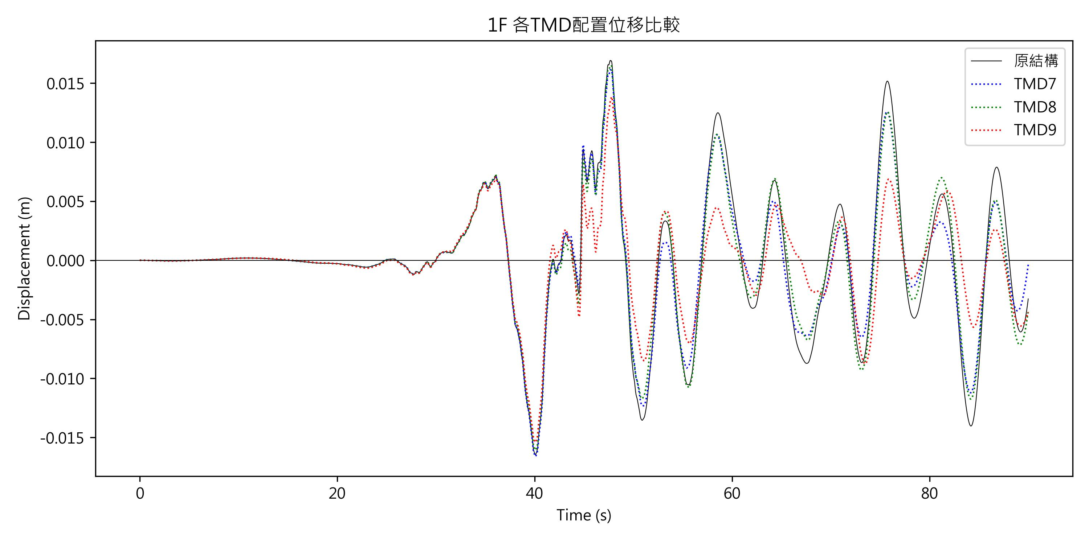
Linear Acceleration-displacement outcome

Slide 14
Linear Acceleration-displacement outcome
No.7 Damper
*PEAK | R.E. | 0.08 | %
*MEAN | R.E. | 5.06 | %
*RMS | R.E. | 1.04 | %
No.8 Damper
*PEAK | R.E. | 1.46 | %
*MEAN | R.E. | 27.99 | %
*RMS | R.E. | 7.55 | %
No.9 Damper
*PEAK | R.E. | 6.79 | %
*MEAN | R.E. | 45.66 | %
*RMS | R.E. | 23.66 | %
2F | PEAK (m) | MEAN (m) | RMS (m)
原結構 | 3.078141e-02 | -1.526732e-04 | 7.741529e-03
No.7 Damper | 3.080720e-02 | -1.603916e-04 | 7.661315e-03
No.8 Damper | 3.033142e-02 | -1.954035e-04 | 7.156774e-03
No.9 Damper | 2.869234e-02 | -8.296492e-05 | 5.909666e-03

Slide 15
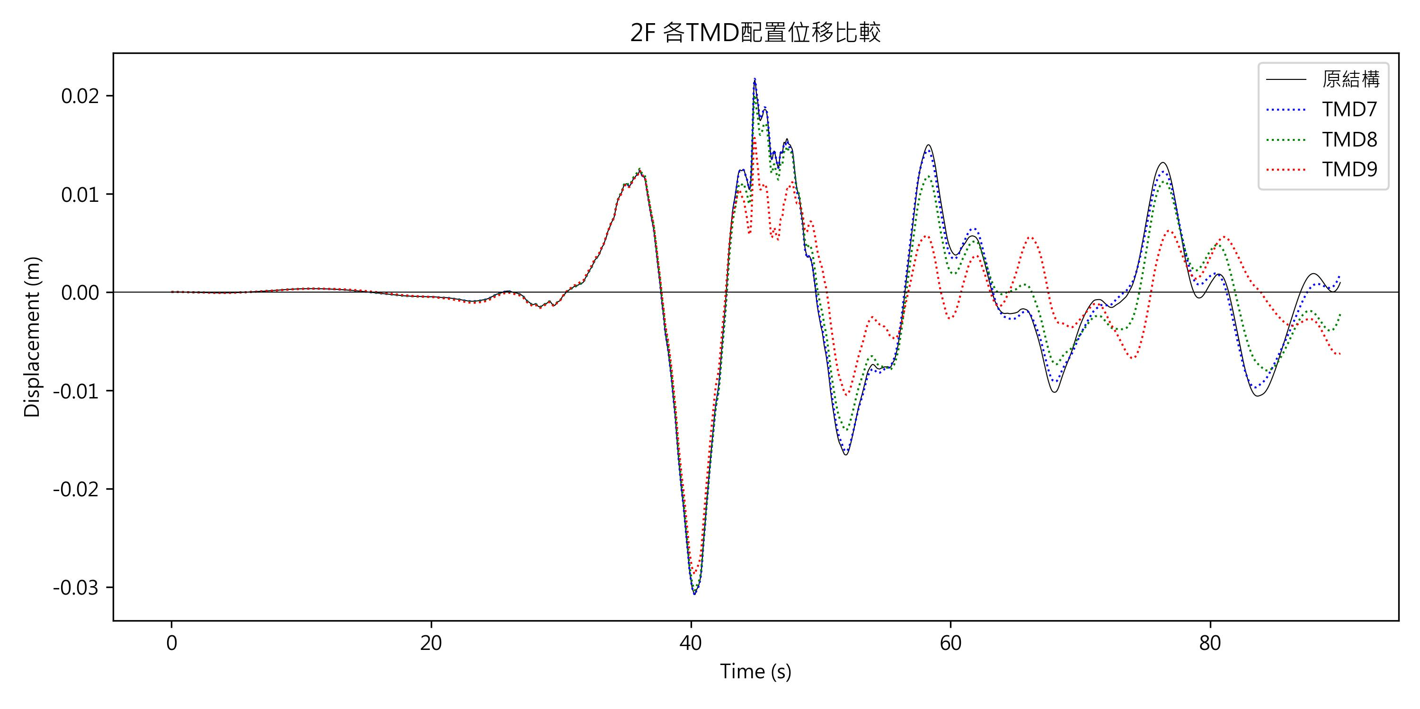
Linear Acceleration-displacement outcome

Slide 16
Linear Acceleration-displacement outcome
No.7 Damper
*PEAK | R.E. | 0.13 | %
*MEAN | R.E. | 8.35 | %
*RMS | R.E. | 3.13 | %
No.8 Damper
*PEAK | R.E. | 2.08 | %
*MEAN | R.E. | 37.80 | %
*RMS | R.E. | 8.23 | %
No.9 Damper
*PEAK | R.E. | 6.46 | %
*MEAN | R.E. | 32.77 | %
*RMS | R.E. | 22.09 | %
3F | PEAK (m) | MEAN (m) | RMS (m)
原結構 | 4.042280e-02 | -1.407705e-04 | 1.093458e-02
No.7 Damper | 4.037202e-02 | -1.525263e-04 | 1.059252e-02
No.8 Damper | 3.958145e-02 | -1.939797e-04 | 1.003441e-02
No.9 Damper | 3.781008e-02 | -9.464258e-05 | 8.519637e-03

Slide 17
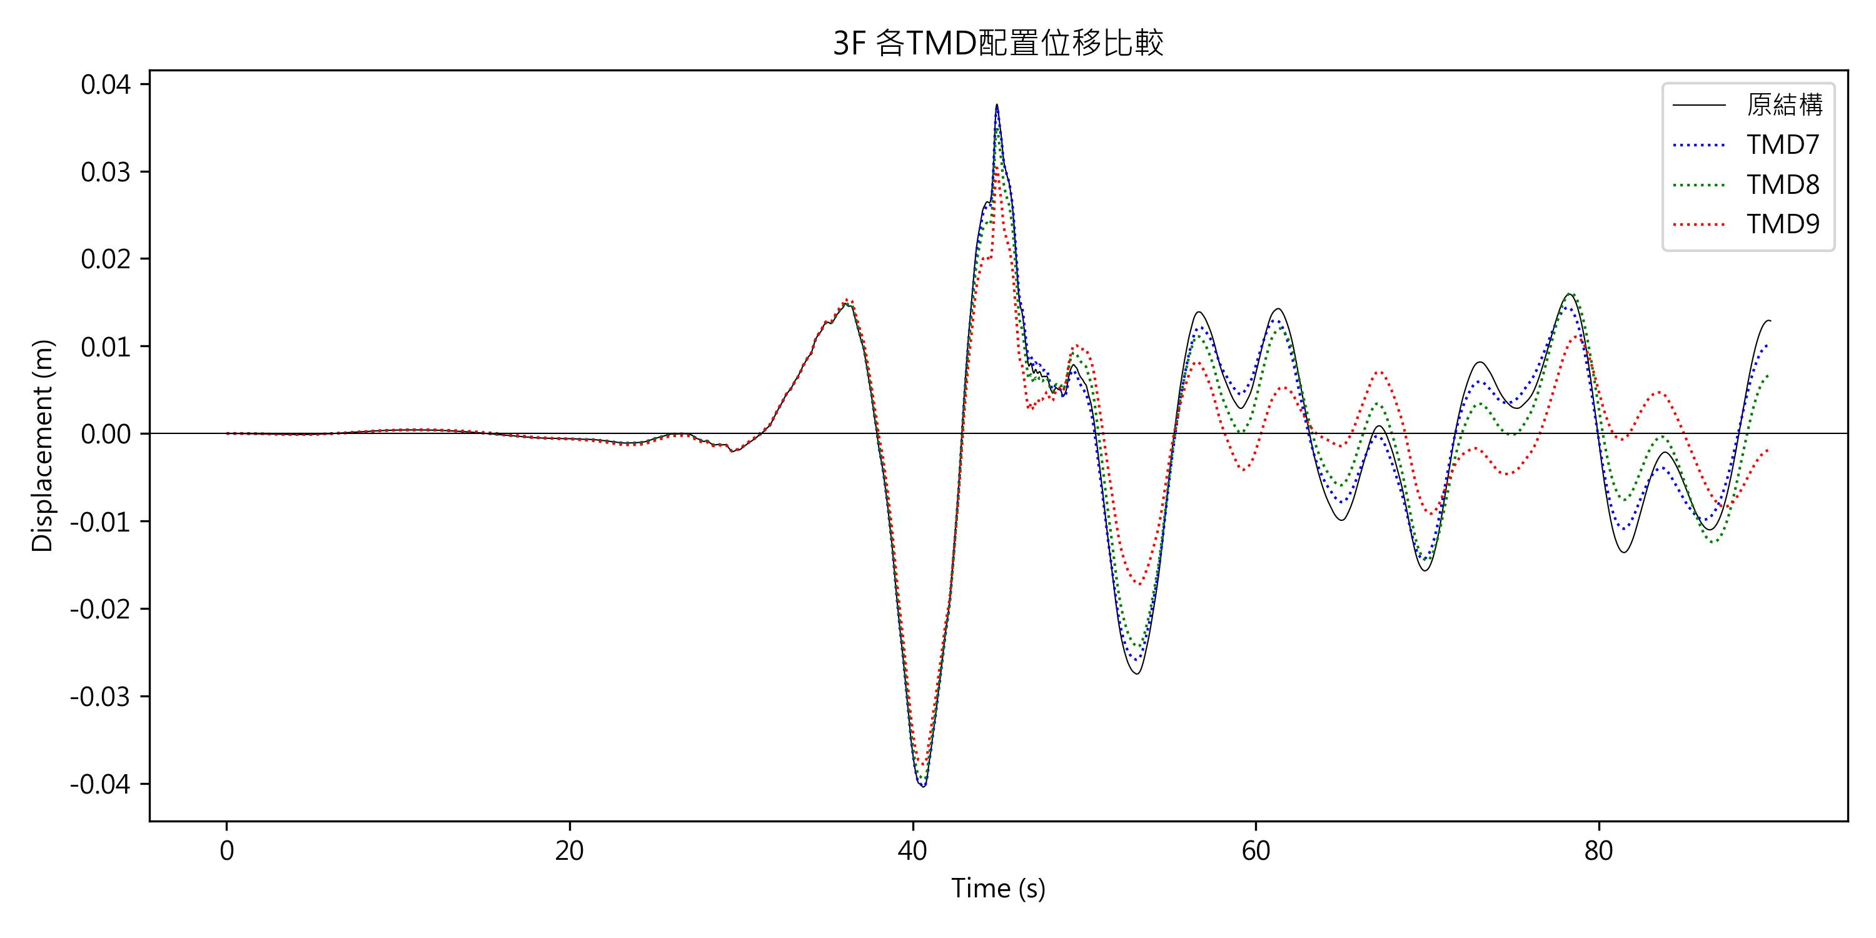
Linear Acceleration-displacement outcome

Slide 18
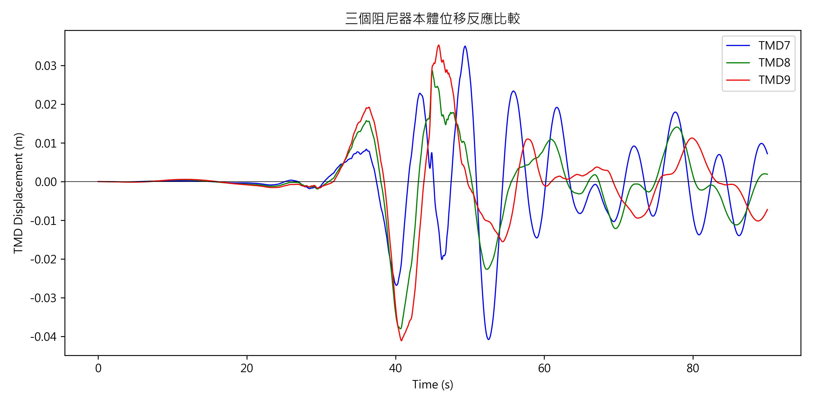
Displacement Response of different Dampers

Slide 19
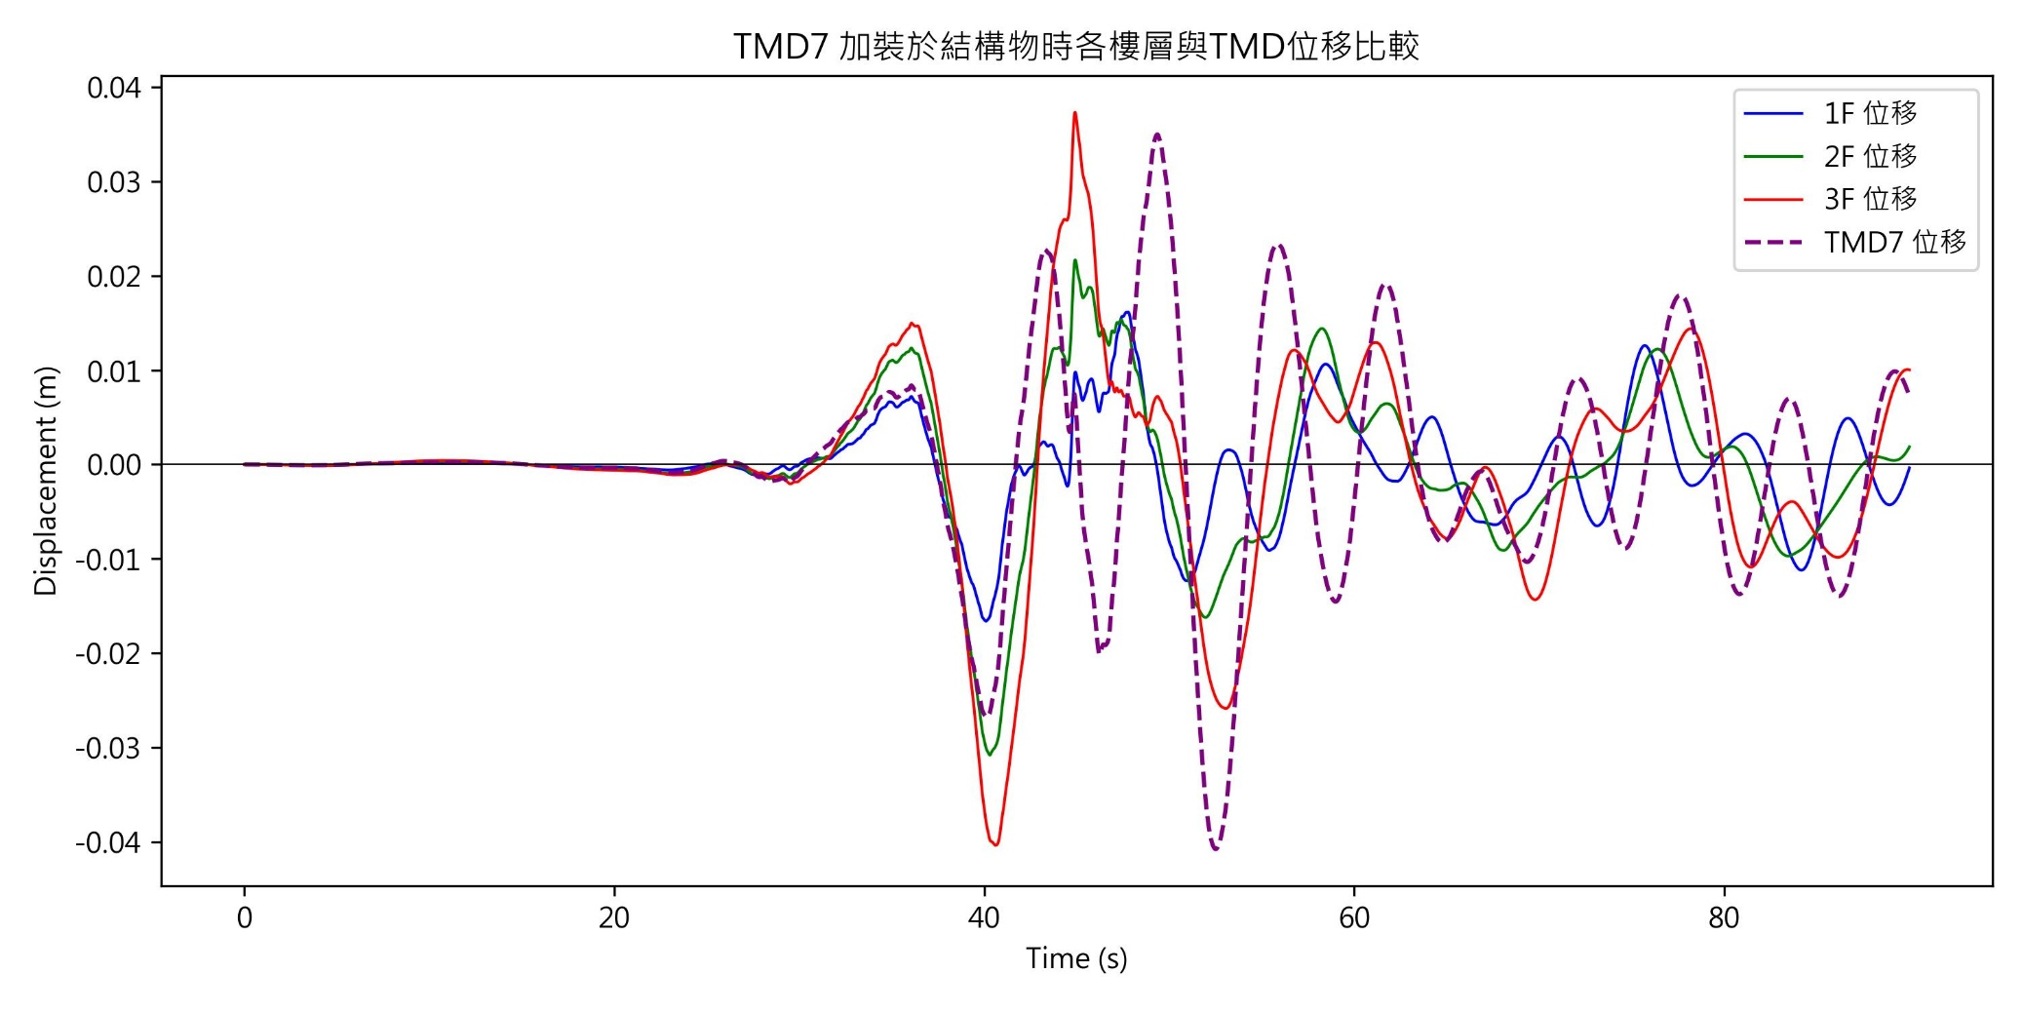
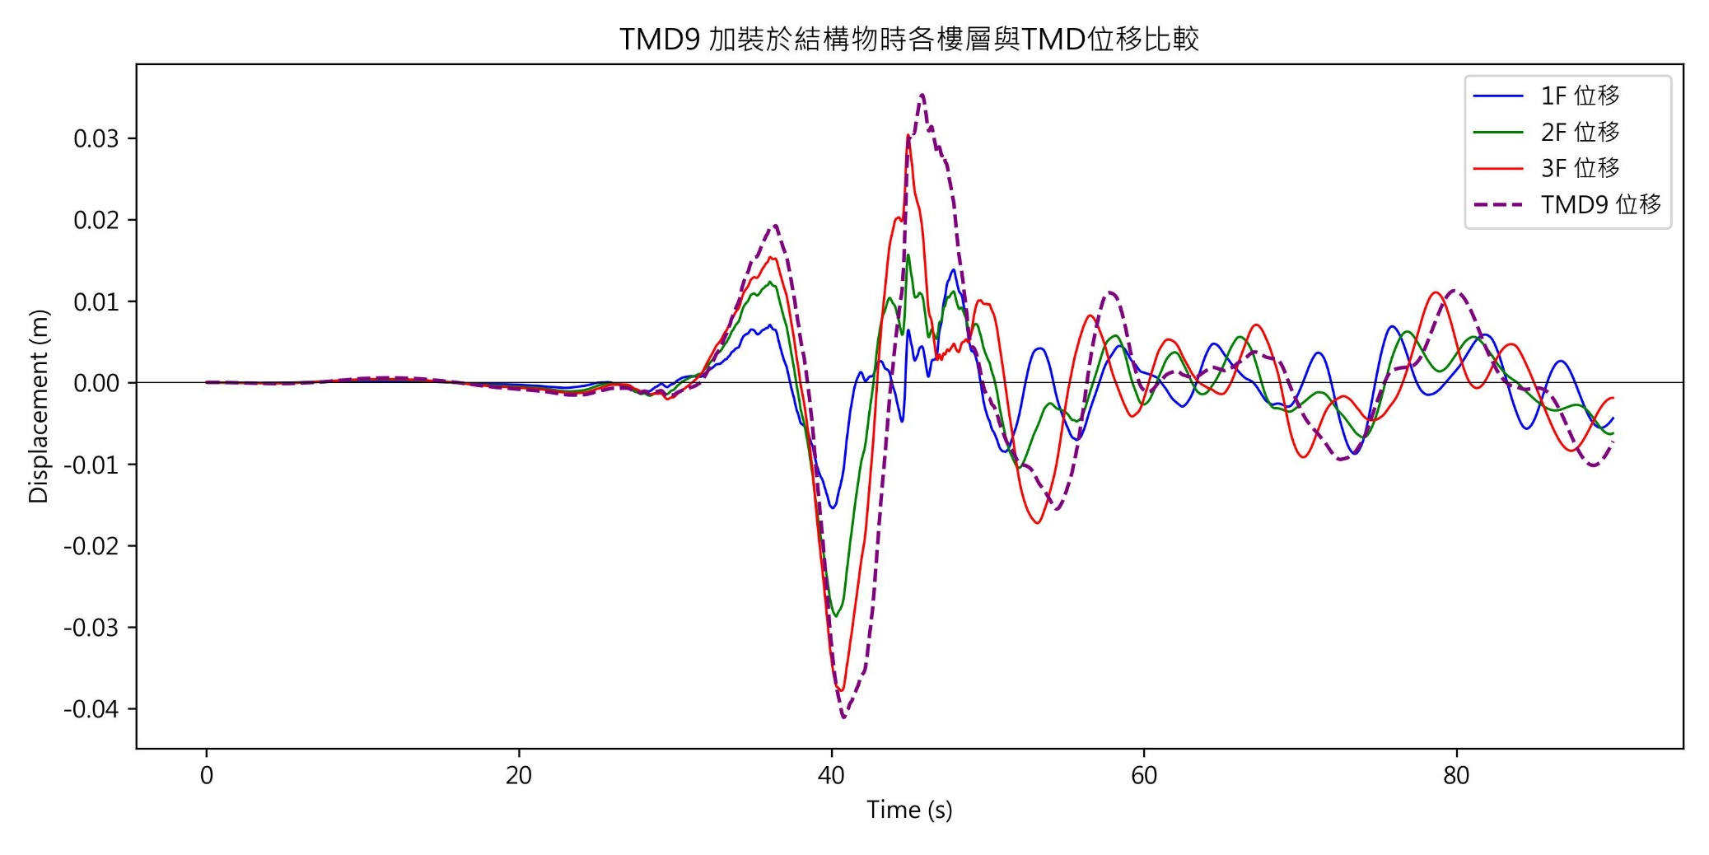
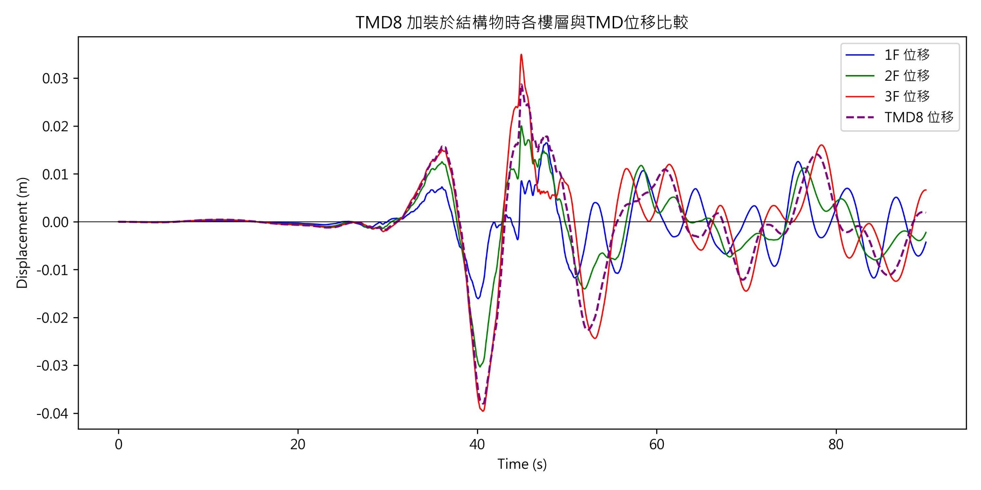
Displacement Response of structure

Slide 20
Kobe Results from Python code
with illustration and comparison

Slide 21
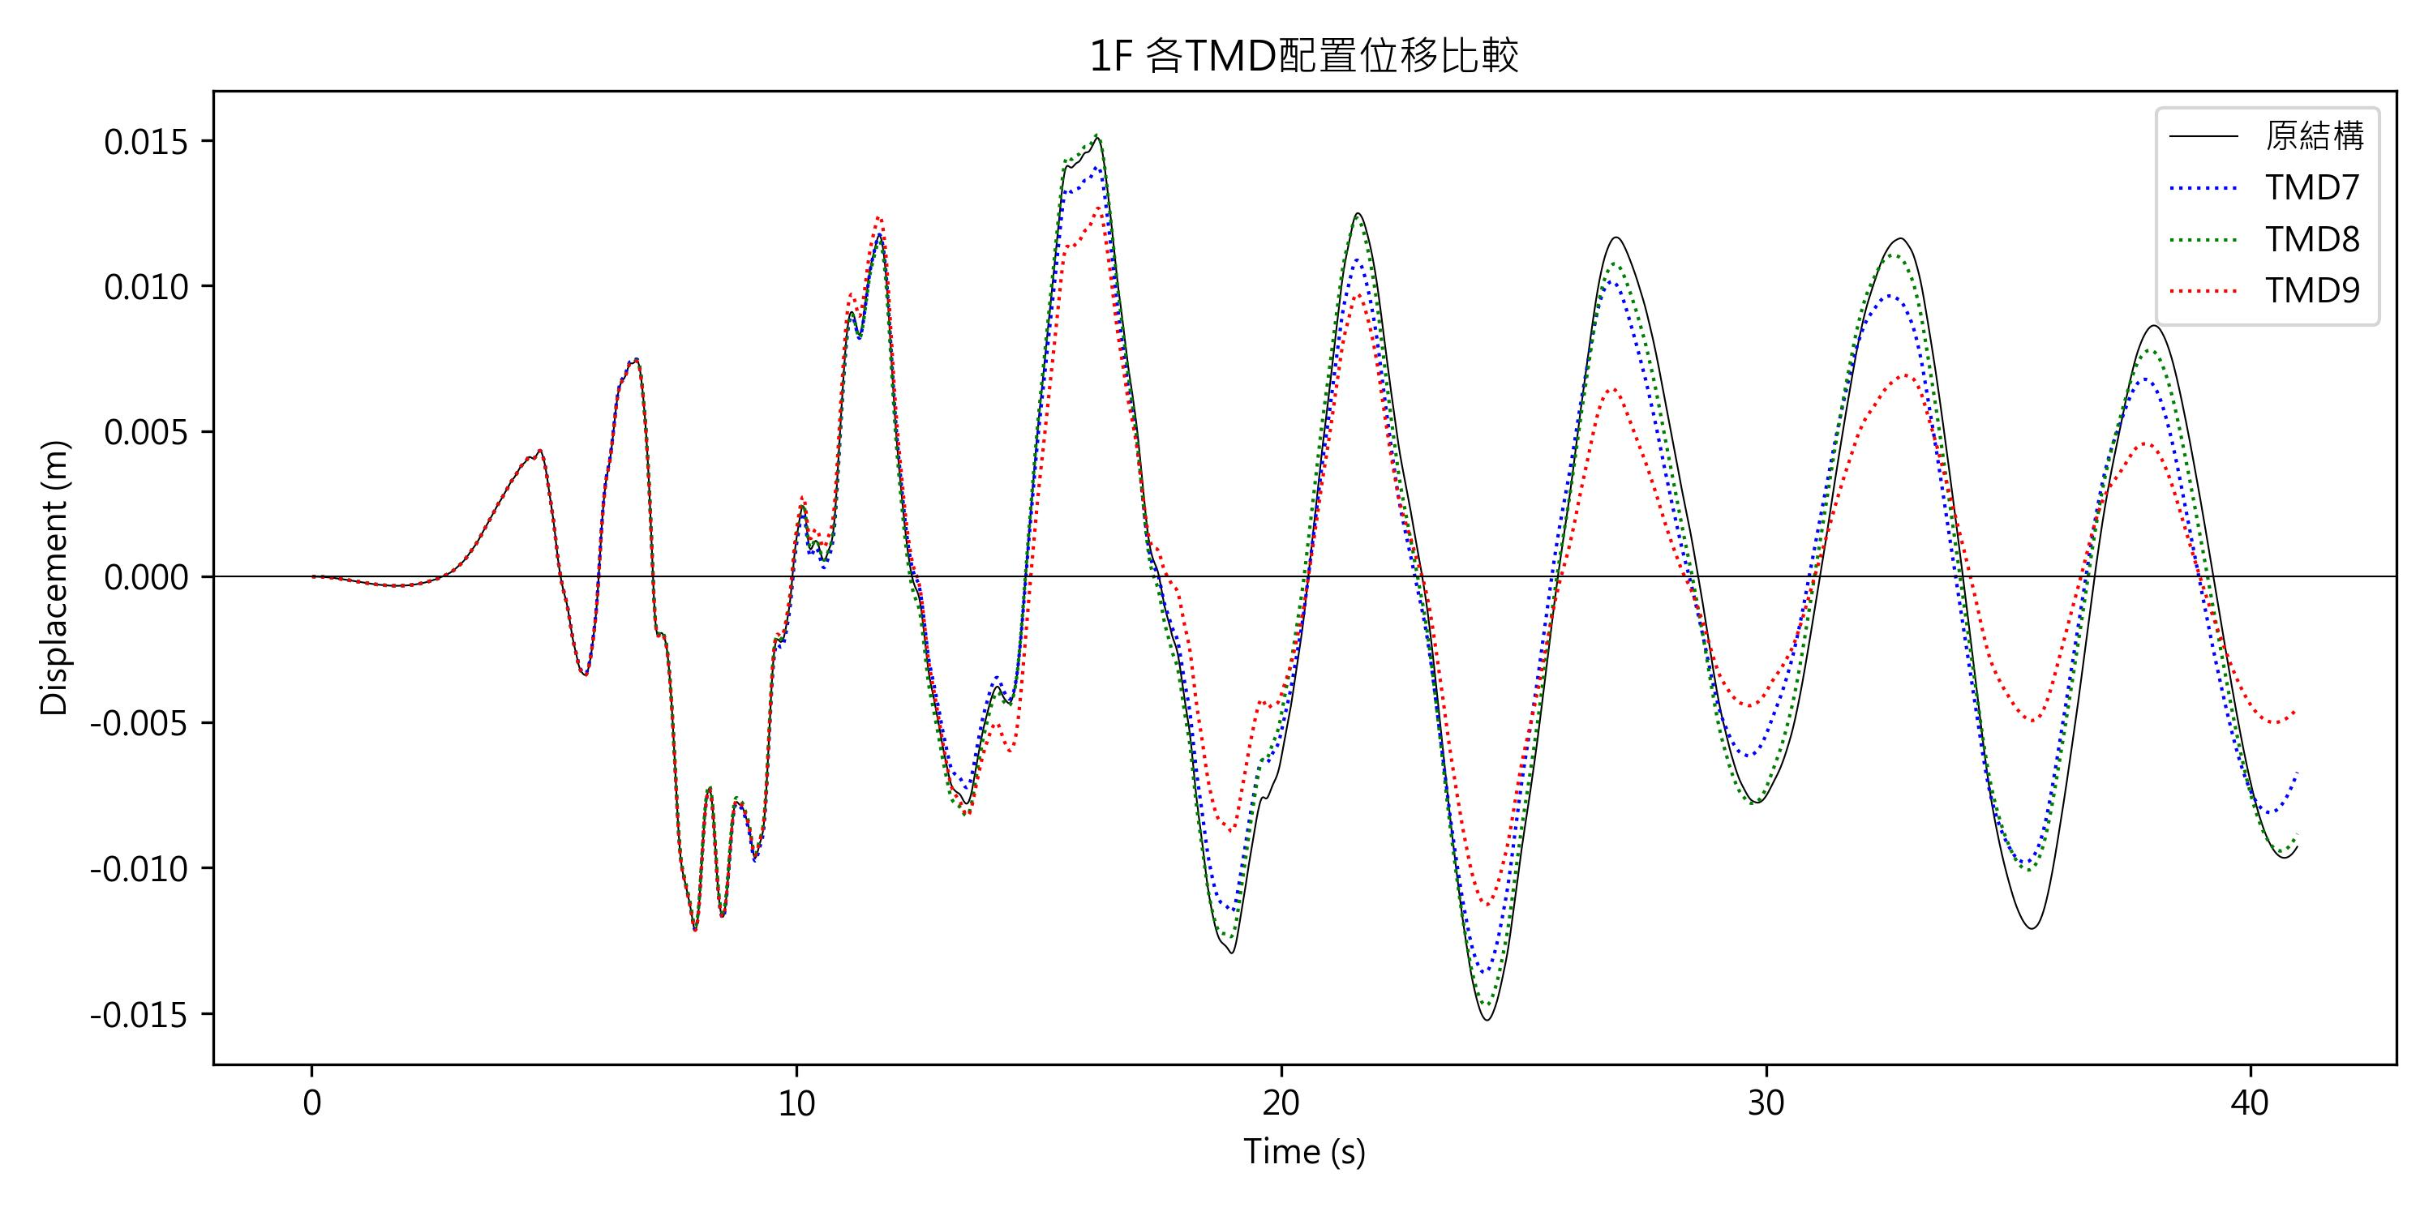
Linear Acceleration-displacement outcome
原結構
PEAK | 1.524601e-02 |  | m
MEAN | -1.247041e-04 |  | m
RMS | 7.265906e-03 |  | m
No.7 Damper
*PEAK | R.E. | 7.52 | %
*MEAN | R.E. | 25.87 | %
*RMS | R.E. | 10.91 | %
No.8 Damper
*PEAK | R.E. | 0.48 | %
*MEAN | R.E. | 9.11 | %
*RMS | R.E. | 3.74 | %
No.9 Damper
*PEAK | R.E. | 16.99 | %
*MEAN | R.E. | 87.83 | %
*RMS | R.E. | 26.44 | %

Slide 22
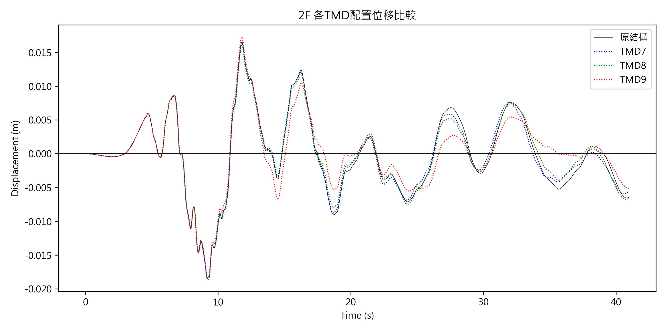
Linear Acceleration-displacement outcome
原結構
PEAK | 1.859557e-02 |  | m
MEAN | -1.717518e-04 |  | m
RMS | 5.967342e-03 |  | m
No.7 Damper
*PEAK | R.E. | 0.01 | %
*MEAN | R.E. | 10.94 | %
*RMS | R.E. | 2.18 | %
No.8 Damper
*PEAK | R.E. | 0.88 | %
*MEAN | R.E. | 23.33 | %
*RMS | R.E. | 3.66 | %
No.9 Damper
*PEAK | R.E. | 2.20 | %
*MEAN | R.E. | 114.42 | %
*RMS | R.E. | 10.79 | %

Slide 23
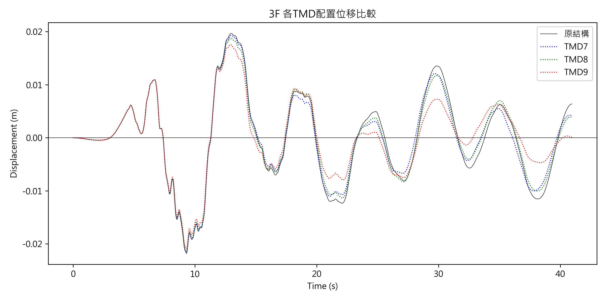
Linear Acceleration-displacement outcome
原結構
PEAK | 2.178636e-02 |  | m
MEAN | -1.843362e-04 |  | m
RMS | 8.488394e-03 |  | m
No.7 Damper
*PEAK | R.E. | 0.41 | %
*MEAN | R.E. | 17.70 | %
*RMS | R.E. | 5.38 | %
No.8 Damper
*PEAK | R.E. | 1.40 | %
*MEAN | R.E. | 40.31 | %
*RMS | R.E. | 5.14 | %
No.9 Damper
*PEAK | R.E. | 3.78 | %
*MEAN | R.E. | 129.77 | %
*RMS | R.E. | 16.33 | %

Slide 24
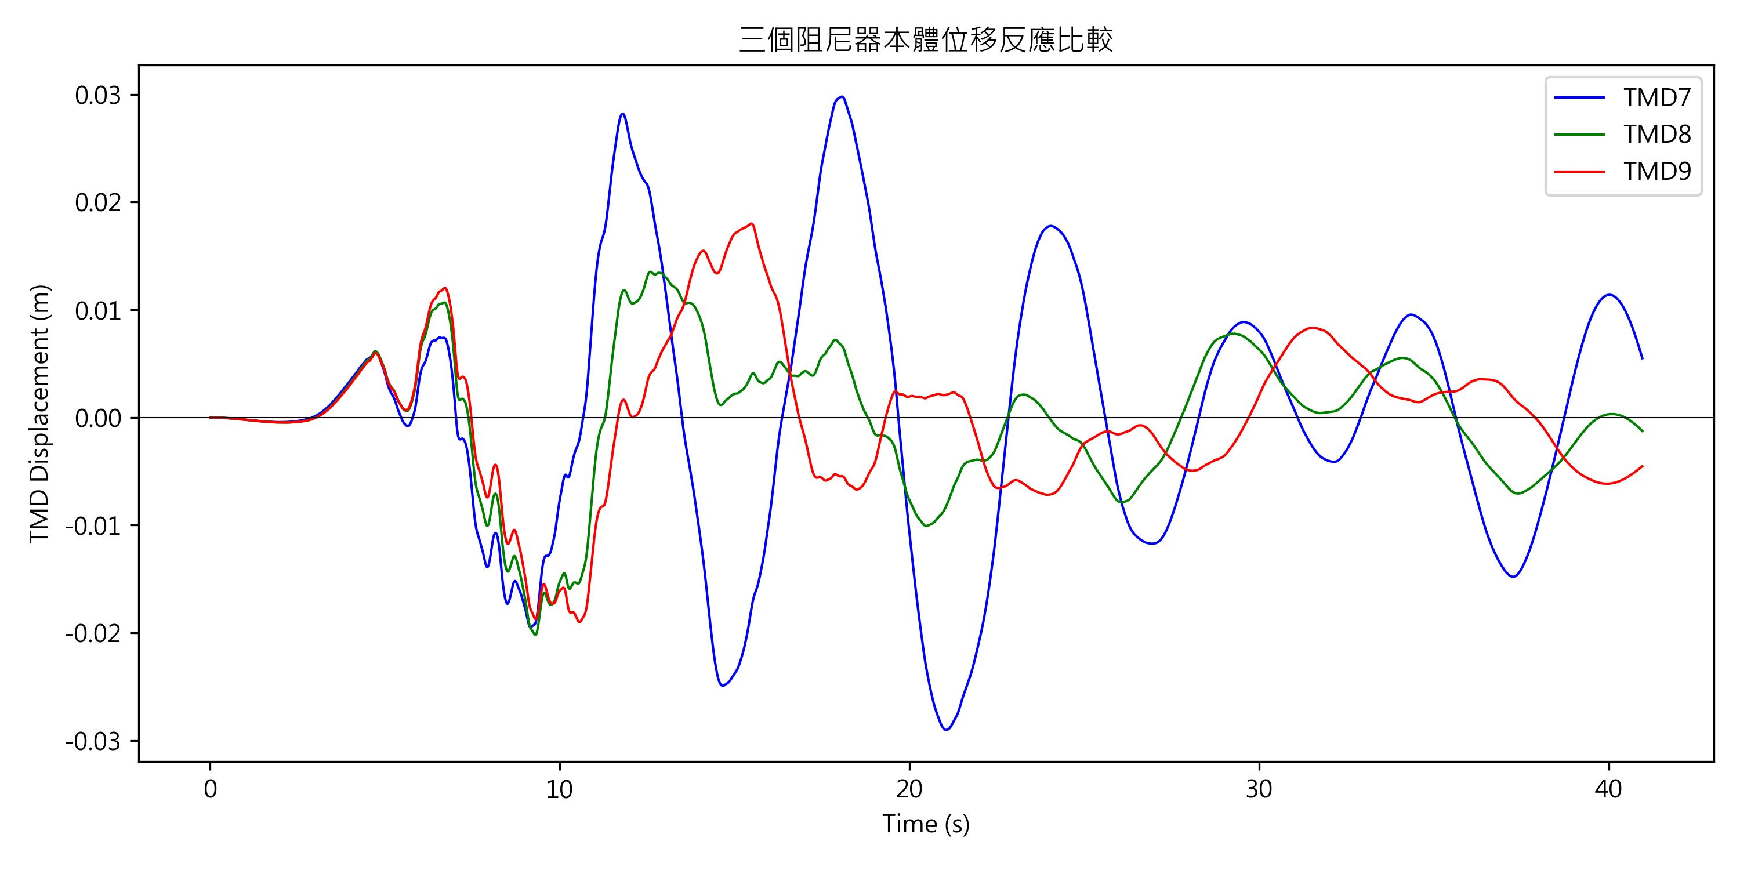
Displacement Response of different Dampers

Slide 25
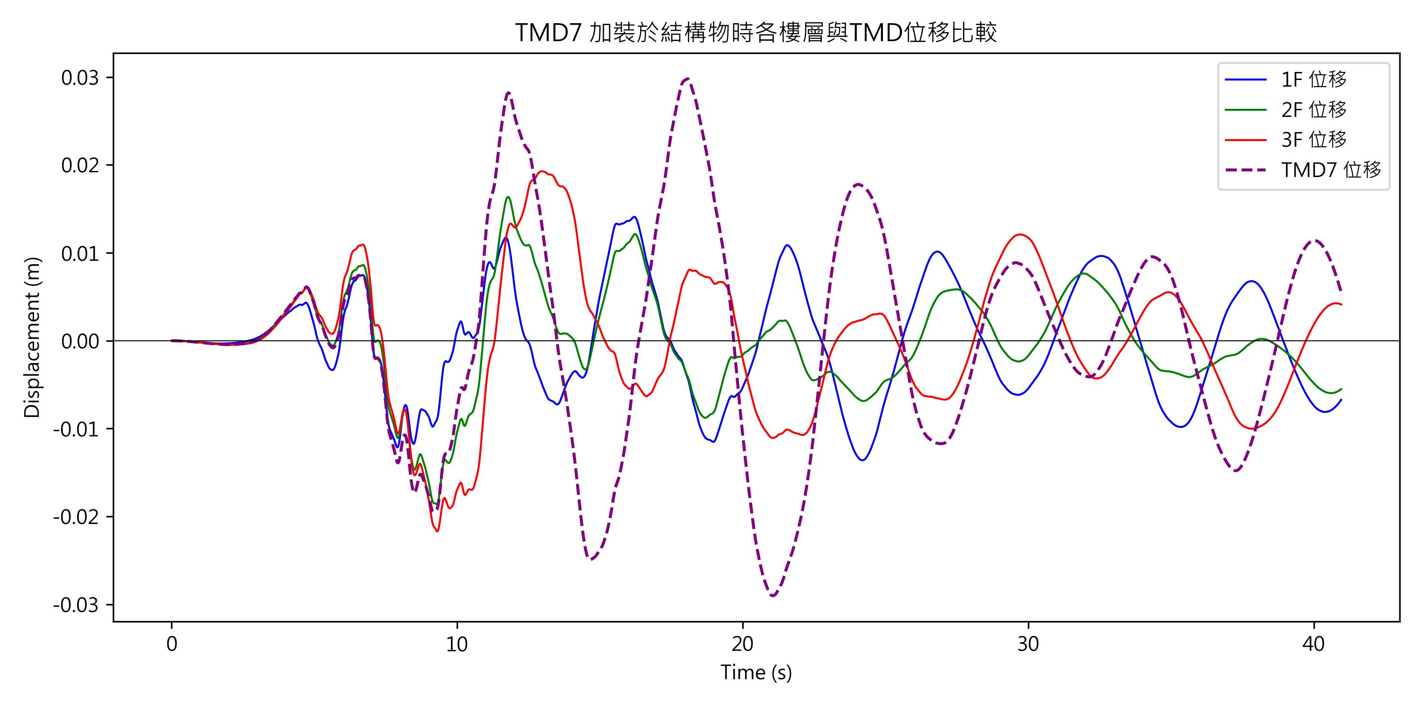
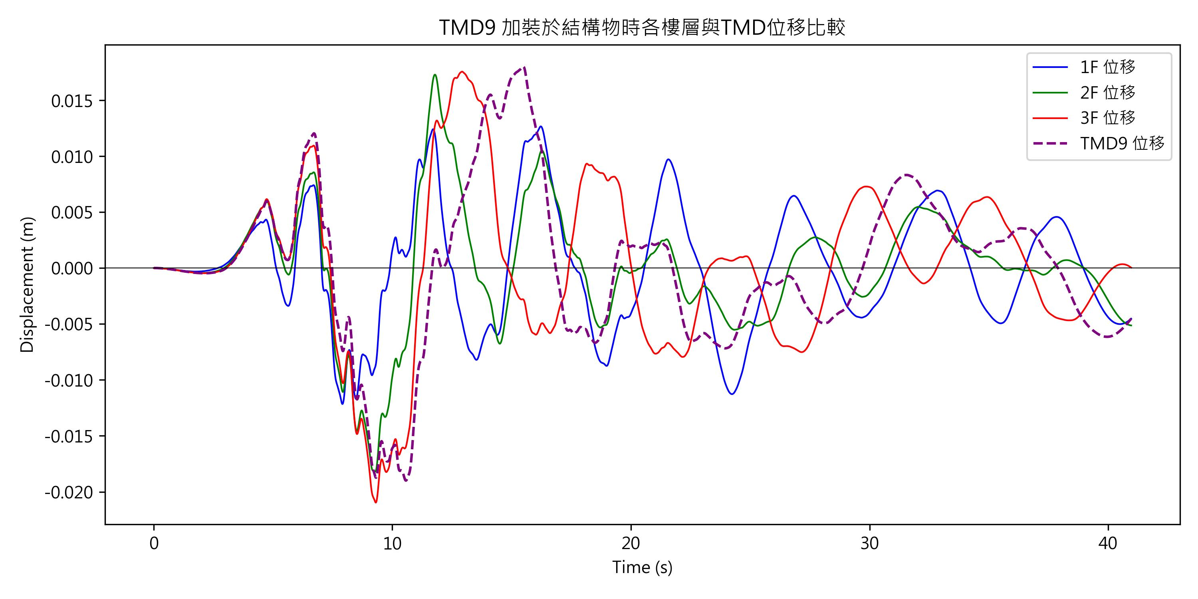
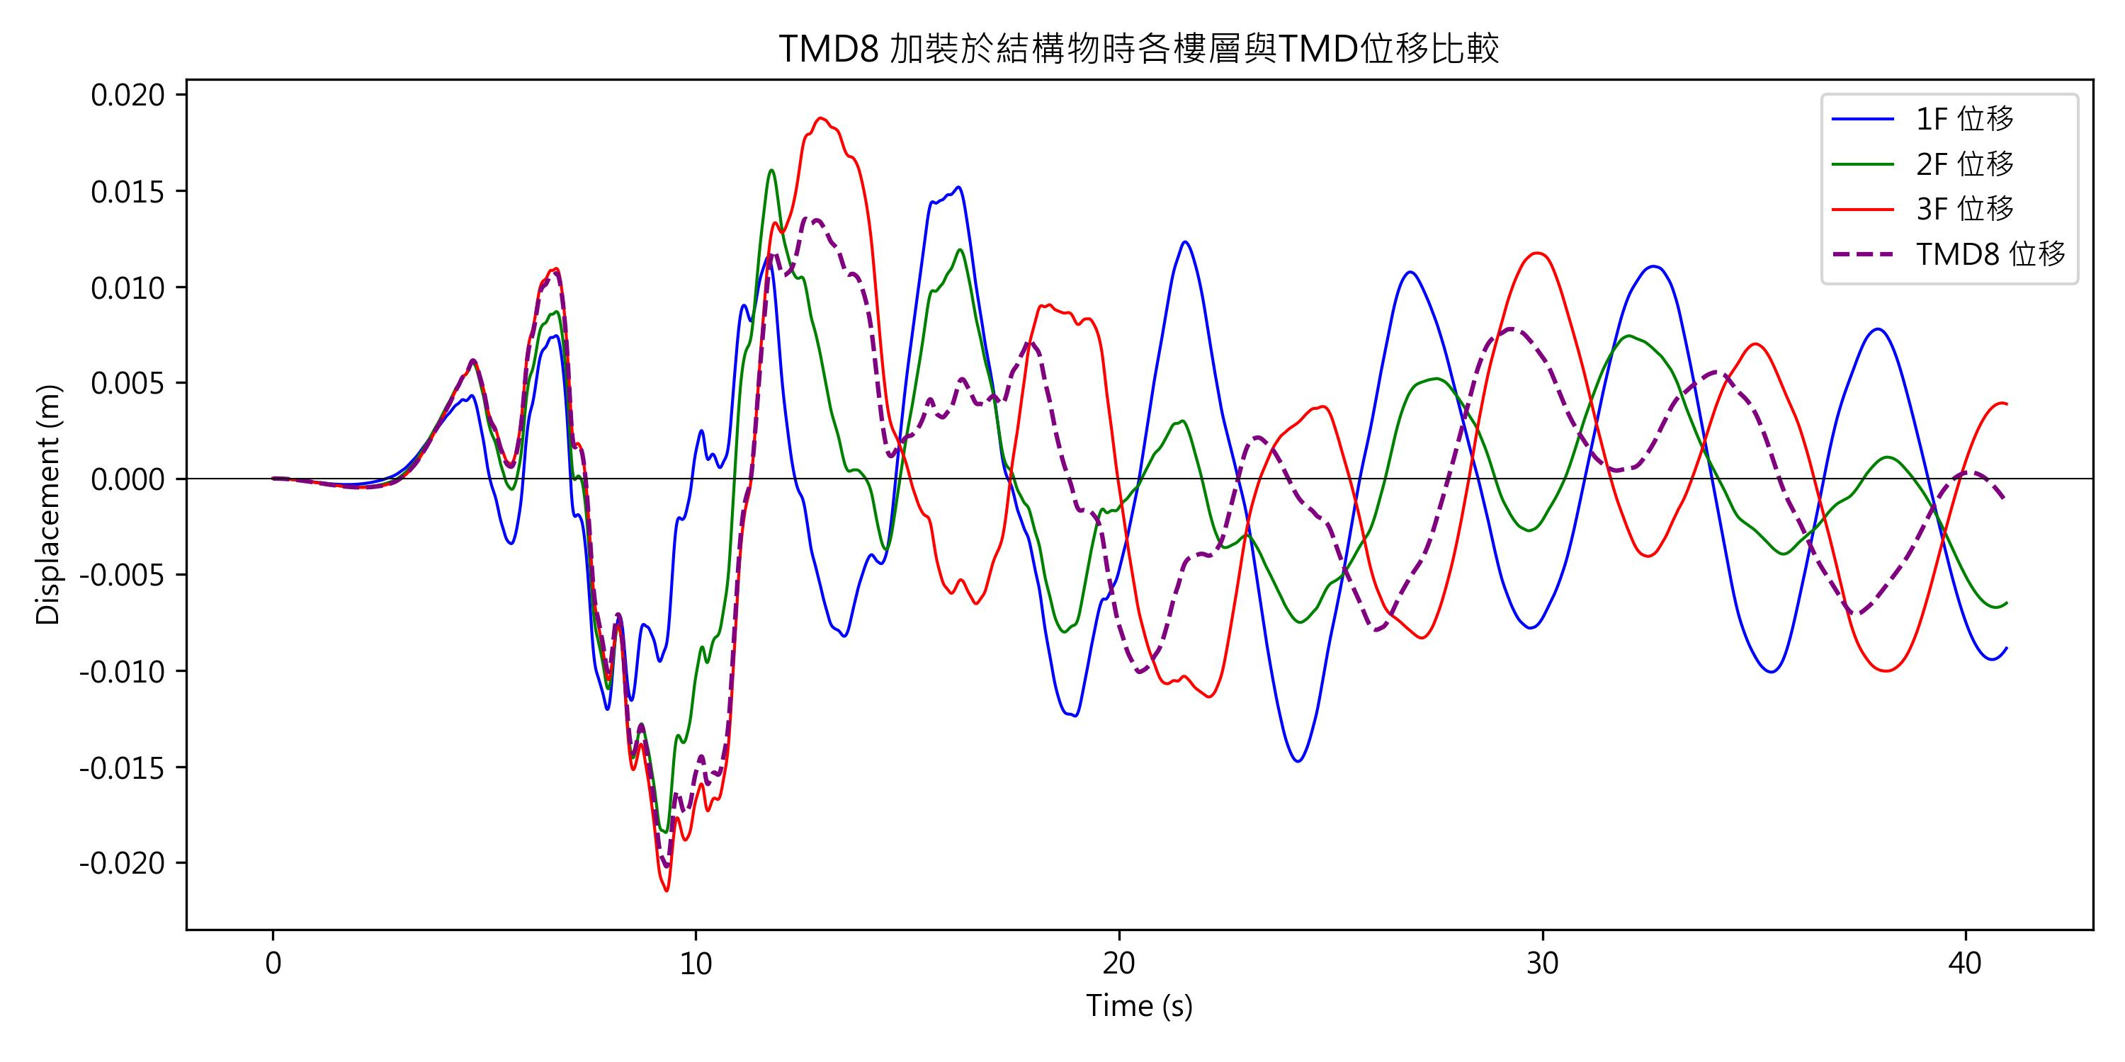
Displacement Response of structure

Slide 26
Summary
What we have found in ChiChi quake input:
attenuation | peak value(%) |  |  | RMS value(%)
 | 1F | 2F | 3F | 1F | 2F | 3F
Damper 7 | 1.87 | 0.08 | 0.13 | 11.97 | 1.04 | 3.13
Damper 8 | 2.65 | 1.46 | 2.08 | 8.72 | 7.55 | 8.23
Damper 9 | 8.93 | 6.79 | 6.46 | 32.07 | 23.66 | 22.09
In this study, few things we have done:
Use Python code to calculate three floor shear house system displacement.
Find out the modal period and natural frequency of structures and compare the difference due to damper.
Plot all the information of each floor displacement response to see the effect of mitigation by various dampers.
Quantify each dampers properties by comparing Peak, Mean, RMS values.
What we have found in Kobe quake input:
attenuation | peak value(%) |  |  | RMS value(%)
 | 1F | 2F | 3F | 1F | 2F | 3F
Damper 7 | 7.52 | 0.01 | 0.41 | 10.91 | 2.18 | 5.38
Damper 8 | 0.48 | 0.88 | 1.40 | 3.74 | 3.66 | 5.14
Damper 9 | 16.99 | 2.20 | 3.78 | 26.44 | 10.79 | 16.33

Slide 27
name | assignment
涂子彧 | Coding、Presentation、Edit slides
邱昱倫 | Coding、Presentation、Edit slides、Edit diagram
周芷琦 | Presentation、Edit slides、software
分工表

Slide 28

Thank you for your listening.

